Slide 1
How to use
The staff team can work as one group or split into several groups to enable discussion. If the group is split it is important that each team can feedback.
The slides should be worked through one at a time, a time limit can be set for each slide or just work through at your own pace.
Each slide will take you through the incident as it evolves and set out a series of questions that should be discussed. The notes section will provide some answers to refer to after each slide.
The staff member taking the lead on this activity should note down key points and actions that are discussed. These can help formulate a review of the crisis management policy.
Introduction
These cards have been designed as a desk top activity to be used within staff meetings.
The aim of the cards is to:-
Spark discussion into crisis management on school trips.
For staff to become familiar with different incidents that could occur and the different ways in which they could be managed.
Prompt a review of the establishment's crisis management plan for offsite visits.

Slide 2
Incident Scenario

Slide 3
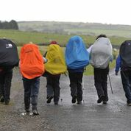
Setting the Scene
A group of 7 students are participating in a gold assessed Duke of Edinburgh Award hike in Wales. They are being remotely supervised over the expedition. The expedition started Friday morning and will finish Monday evening. Check points have been identified, where staff will meet the group or where the group can leave drop cards in order to monitor progress.
The staff team is made up of the expedition leader, an assistant leader and a supporting member of staff. The students are all 17 years old. An Assessor is meeting the group a various points but is not involved in any supervision responsibility.
Q1 What level of planning would be required for this visit?
Q2 Who would give approval?
Notes:
This is a residential visit, which includes adventure activities, it would need specific planning in line with the DofE regulations. Staff would need the appropriate qualifications to lead the visit and the participants would need adequate training to complete the expedition.
ESCC would need to grant approval for this visit along with the EVC and head teacher. If the school is an academy that has purchased an SLA with ESCC they would be expected to follow the advice and guidance from the outdoor education advisor. Is the school is an academy that has not purchased an SLA they would be expected to seek approval from their technical adviser.

Slide 4
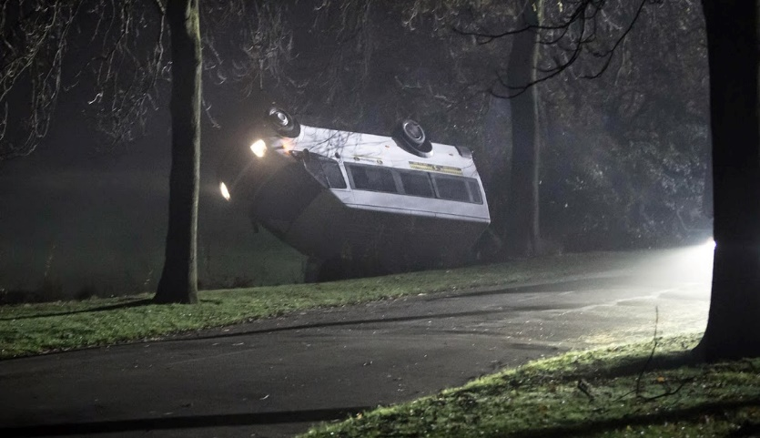
Incident
On Sunday the expedition leader is driving the minibus to a checkpoint and is involved in a collision with another vehicle. The emergency services are called, the expedition leader is conscious but requires hospital treatment.
Q3 What information would the visit leader have to give the emergency services?
Q4 If the visit leader was unconscious, what information might be in the minibus or on the visit leader to help the emergency services?
Notes:
3. Explanation that it is a school visit. The name of the school, contact information for other staff on the visit or the emergency contact at base.
4. Identification to show they are from a school, trip folder with the details of the visit, visit phone

Slide 5
Inject 1 10:00
The police inform the expedition leader that their mobile phone will be held so that it can be examined and cannot be used.
Q5 What problems could this cause?
Notes:
5. Is it the number provided to the students to contact in the event of an emergency? Are the numbers stored into the phone listed elsewhere? Does the emergency contact at the school site have all staff numbers on the trip?

Slide 6
Inject 2 10:05
The expedition leader informs the police officer there is a folder in the minibus with all the visit details in it and to call the assistant leader.
Q6 How is visit information carried on school trips?
Q7 Are there any emergency numbers accessible in the school minibus?
Q8 Is there a GDPR risk in taking data on trips?
Notes:
Q6. If the visit is on Exeant you could just rely on having the internet to access the visit information. You are not required to take consent forms on UK based visits. You are likely to have details of the route, check points, location of campsites, participant details – medical/emergency contact, staff details – medical and next of kin contact, local medical facilities, weather information, travel routes, assessor information.
Q7. Is there a sticker in the minibus with the school contact information? Breakdown information?
Q8. GDPR is not a reason for not taking information on a visit, information on visits should be secure but accessible, you need to consider who needs to have access and to what information.

Slide 7
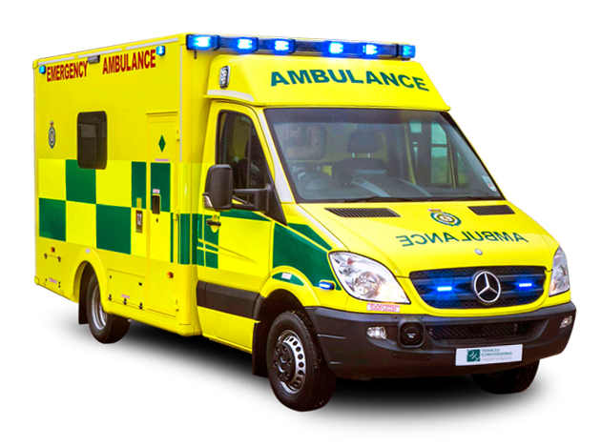
Inject 3 10:20
The assistant leader receives a call from the police and is informed of the incident. They are notified that the expedition leader has been taken to hospital with minor injuries and that the mini bus is not going to be accessible.
Q9 Do you identify an assistant leader for all your visits?
Q10 What attributes do you need an assistant visit leader to have?
Q11 What information would you want the assistant leader to obtain from the police?
Q12 What would you expect the assistant leader to do having received this call?
This Photo by Unknown Author is licensed under CC BY-NC
Notes:
9. Every visit should have an identified assistant leader. Ideally they should help with the planning of the visit so that they have full understanding of the visit details.
10. An assistant leader should know they are the visit leader, be confident and competent to take over from the visit leader if they are required to, they should be inducted into and follow the establishments policies and procedures.
11. The assistant leader would want to know, the condition of their injured colleague, the hospital that they have been taken too, a police contact number, condition of the minibus, location of the incident.
12. Send another member of staff to the check point to see if they can catch the group or locate the drop card, contact the emergency contact at base to inform them of the situation and discuss/formulate a plan

Slide 8
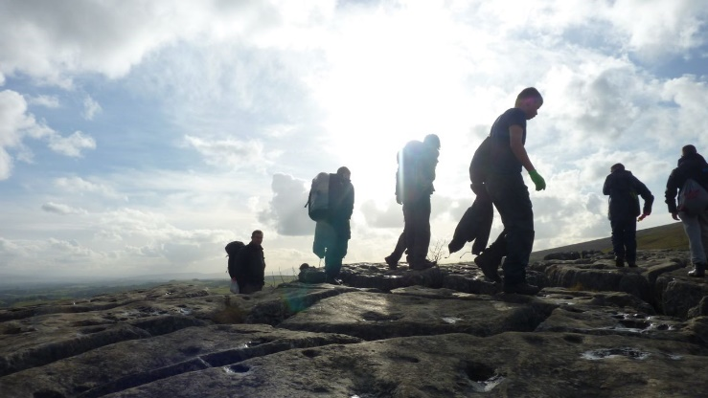
Inject 4 10:25
The group reach their checkpoint where they expected to see a member of staff. They leave a drop card detailing their progress and continue as per the plan.
Q13 Is it safe for the group to continue given the circumstances?
Q14 How would you manage remotely supervising the group?
Notes:
13. You would need to consider the staff experience, qualification and competency in the terrain, other impacts to consider- lack of a minibus, is there an alternative that could be used if needed, the weather conditions could make the expedition challenging and increase the risk, the abilities of the group on the expedition and any needs that they may have. Consideration of the risks v benefits of the continuing the expedition.
14. Devise a plan for the remaining staff to meet the group at check points or the use of drop cards, could the assessor be included in supporting the supervision if needed? Would you need or expect the school to send additional staff if so who, what experience would be helpful.

Slide 9
Inject 5 10:30
The assistant leader notifies the emergency contact of the incident. They have the following issues to address:
The group out on their assessed expedition.
Transport – the mini bus is not available and they only have a member of staff’s car.
The expedition leader in hospital.
Q15 Who is the emergency contact? Would they be contactable over a weekend?
Q16 What attributes would an emergency contact have?
Task:
Devise a plan to address the issues:
Can the expedition continue?
How will you get the group home?
How would you inform the next of kin?
Would you inform the participants and their parents, if so how?
Would you send any staff members to support?
Notes:
15. An emergency contact tends to be a member of SLT, in addition to the school office. They need to be contactable for the duration of the visit, this is 24/7.
16. Sound knowledge of the schools crisis management plan, ability to remain calm and collected in an emergency, good communication and listening skills, supportive, access to contact numbers for additional school staff, details of the visit.

Slide 10
Conclusion
The visit leader was discharged from hospital the following day.
The police established that the visit leader was not at fault for the collision.
The group were able to continue with their assessed expedition, as the conditions were good and staff had the necessary qualifications .
The school sourced another minibus and this was driven to collect the group.
Q17. Would you provide any follow up support after this incident?
Q18. What actions would need to be taken on return?
Q19 . What would the key learning points be?
Notes:
17. It is important to have an understanding of any physical or emotional impact this incident had on the staff members and provide/offer support for this.
18. Ensure the parent/carers are fully aware of the incident, also ensure the participants have been fully informed and debriefed. Review of the incident, there could be some ongoing contact with the police, if an incident log was made this is a really useful way to review the actions that were taken. Report the incident via the schools systems. Management of the damaged minibus, insurance companies, replacement/repairing.
19. This will come down to the plan, actions and crisis management plan you have in place. It is important that all staff on a visit are clear on the emergency procedures for each visit, the emergency contact is contactable and also has access to the details of the visit.

Slide 11
Finally
Review your crisis management plan for offsite visits.
Ensure staff have adequate training for incidents on offsite visits.
Practice and discuss.
Support:
Leanne.Bentley@eastsussex.gov.uk
Julian.Patmore@eastsussex.gov.uk

