Slide 1
Incident Scenario
How to use
The staff team can work as one group or split into several groups to enable discussion. If the group is split it is important that each team can feedback.
The slides should be worked through one at a time, a time limit can be set for each slide or just work through at your own pace.
Each slide will take you through the incident as it evolves and set out a series of questions that should be discussed. The notes section will provide some answers to refer to after each slide.
The staff member taking the lead on this activity should note down key points and actions that are discussed. These can help formulate a review of the crisis management policy.
Introduction
These cards have been designed as a desk top activity to be used within staff meetings.
The aim of the cards is to:-
Spark discussion into crisis management on school trips.
For staff to become familiar with different incidents that could occur and the different ways in which they could be managed.
Prompt a review of the establishment's crisis management plan for offsite visits.

Slide 2
Incident Scenario

Slide 3
Setting the Scene
35 year 4 students are visiting a Castle within East Sussex.
The school has hired a coach to travel to and from the venue.
The journey is approximately 40minutes.
The visit is taking place during school hours.
Q1 What level of planning would be required for this visit?
Q2 Who would give approval for the visit to take place?
Q3 How do you choose your coach company? What checks are in place?
Notes:
One off visit, would require a specific risk assessment coving the venue, activity, group and travel. Consent could be covered by an annual consent form as it is taking place during the school day and is part of the curriculum, or a one off consent form could be used.
2. As this is a local (in county) day visit that does not include adventure activities this can be approved by the schools EVC, in some schools the headteacher may also want to approve the visit.
3. The OEAP National Guidance sets out a checklist for hiring a coach, some considerations, previous experience with a provider, able to cope with the needs of the group, seat belts appropriate for the group, if they subcontract to another company, public liability insurance.
Other consideration – pick up and drop off points, the route, timings, any planned stops, coach rules, on the day introduce yourself to the driver, check the coach for cleanliness and the condition of the coach appears appropriate such as emergency equipment, exits clear. Think about the positioning of staff on the coach to provide supervision.

Slide 4
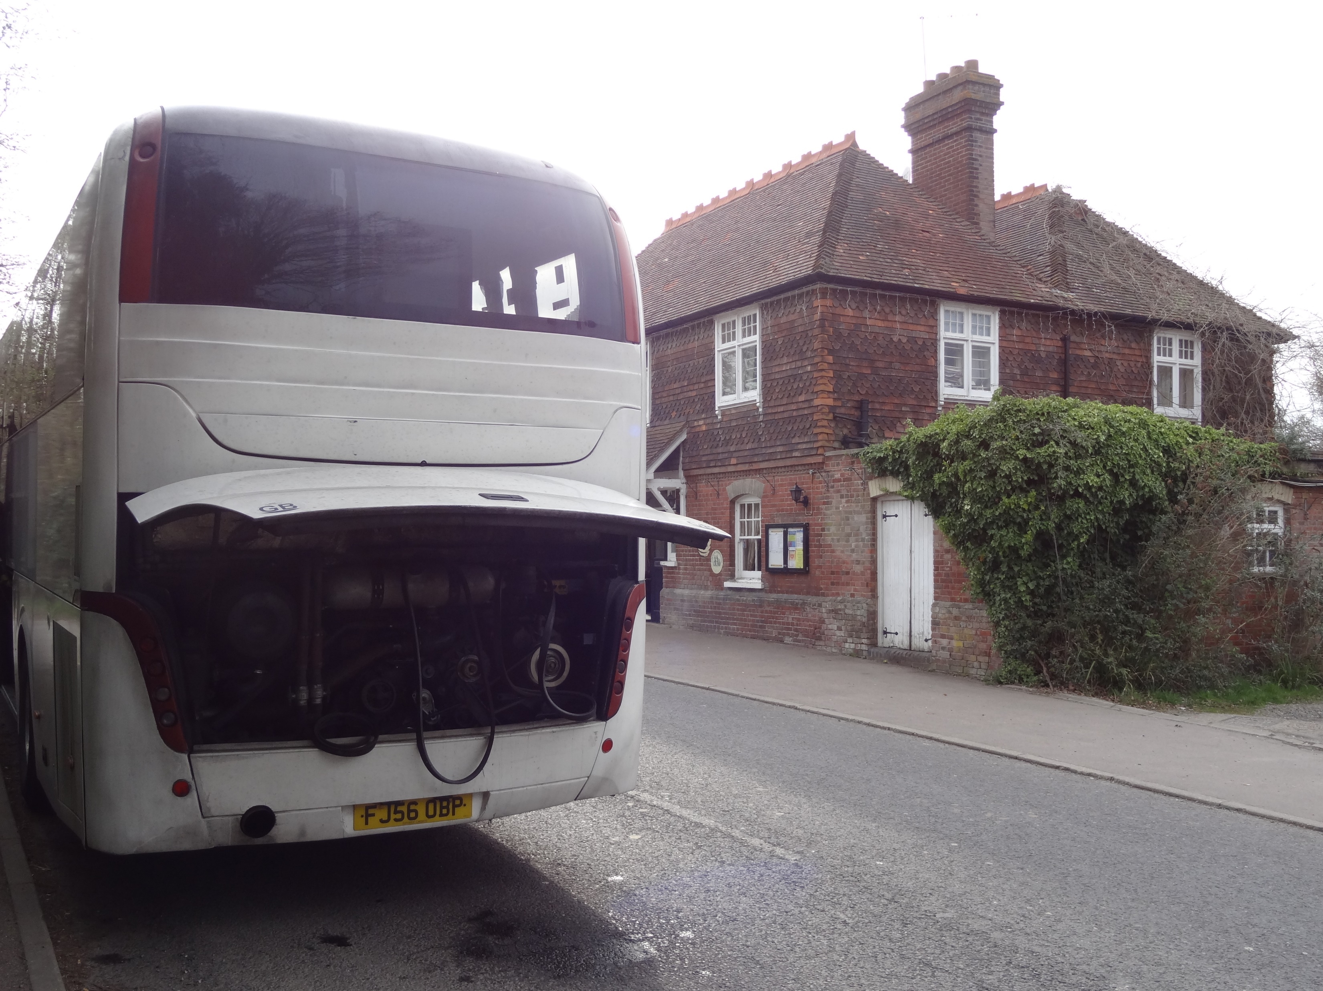
Incident
After a successful visit, the coach is on its return journey to school. The coach is expected to return by the end of the school day. During the return journey the coach breaks down.
Q4 As the visit leader what would you start to think about in your on going dynamic risk assessment?
Notes:
4. Is it safe to stay on the coach or is it safer to get the students off the coach and to a safe location? Informing the school that there could be a delay, if there is a significant delay any needs of the pupils that will need to be considered. Dependant on the road/conditions contacting the local police maybe useful as they can help with the flow of traffic, increasing the safety of the children on the coach.

Slide 5
Interject 2 2:30
The coach driver informs the visit leader that the coach is not able to be fixed by the side of the road. They have contacted the company to get a replacement, but as this is school pick up time, they have no coaches available for the next couple of hours.
Q5 What problems does the delay cause?
Q6 What would impact upon your decision to remove the children from the coach or to keep them on the coach?
Q7 What actions would you take as the visit lead?
Notes:
5. Missing pick up time at the end of the school day, parents or school buses. Staff on the visit could be involved in clubs/meetings or have their own children to collect or other personal commitments.
6. The location of the breakdown, the type of road, the weather condition, the amount of daylight/visibility, is there a safe area to place 35 children safely.
7. Update the schools emergency contact, inform the staff on the visit, discuss the plan with the school and the staff on the visit. Provide the students with an update on the plan. If students have their own phones, may need to think about the children getting messages to parents before the school does, which could create confusion and an influx in calls to the school.

Slide 6
Interject 3 2:35
The visit leader contacts the school emergency contact and informs them of the incident.
Q8 Who is the emergency contact for visits?
Q9 What action would the emergency contact take?
Q10 Are there any alternatives to waiting for a coach?
Notes:
8. There should be a designated emergency contact for each visit, the office is an automatic number for during the school day, but there should be an additional especially if the visit falls outside of school hours.
9. Inform head/ SLT, discuss informing the parents of a delay and how this would be carried out (calls? Messaging system), contact the coach company? Cover any clubs/meetings that would be affected, provide a safe holding area for any students that cannot be picked up (staff’s children or if parent helpers on the visit their children). Check what the contract/policy is with the coach company. Plan for those students that will miss the school bus.
10. Other coach companies? Minibuses available?

Slide 7
Interject 4 2:50
The school starts to contact the parents to inform them of the delay. Some parents have asked for the location of the breakdown as they will go and collect their child.
Q11 What plan would be in place for those children that will miss school buses?
Q12 Would you allow parents to drive to collect their child?
Notes:
11. Can parents arrange transport? Can the school provide alternative transport?
12. Pros and Cons, depends where the breakdown has occurred, would it cause a build up on traffic and another obstruction to the road? Is there a safe place for parents to park? Would you know who could collect each child? Would you be able to keep a register of who has been collected?

Slide 8
Interject 5 3:10
The children are starting to get restless.
Q13 As the visit leader what would you do to keep the children settled?
Q14 What other considerations do you need to think about?
Notes:
Support staff to engage in games? Reading time? Allowing small groups off to stretch legs and get fresh air (if safe to do so).
People needing the toilet, depending on the weather becoming too hot/cold, any medical needs of the group, additional needs which could be impacted by the change/disruption.

Slide 9
Interject 6 3:30
A couple of parents have located the coach and requested their son/daughter disembark.
Q15 What, if any problems, would be caused by this?
Notes:
15. Keeping a list of who has departed, ensuring that is with the correct parent.

Slide 10
Interject 7 4:30
A replacement coach has arrived to take the group back to the school site.
Q16 What arrangements would need to be made and how would this be carried out?
Notes:
16. Ensuring a safe place for disembarking and a safe place for getting on the new coach. Checking the students getting on the coach, ensuring they have all their belongings. Confirm with the new driver the route, drop off point and plan. Inform the emergency contact that the group is on their way with a estimated time of arrival.

Slide 11
Conclusion
The replacement bus, took the group back to the school site and returned just after 5pm.
A member of SLT waited at the school for the group returning.
The parents/carers arrived to collect their children from the school.
Q17 What would be the tasks on the return to school?
Notes:
17. Ensure the students have been collected by their parent, wait with any children that have been delayed in being picked up. Visit leader to feedback to EVC Head on the incident and how it was managed by coach company. Follow up any concerns with coach company or lessons learnt in the management of the incident.

Slide 12
Finally
Review your crisis management plan for offsite visits.
Ensure staff have adequate training for incidents on offsite visits.
Practice and discuss.
Support:
Leanne.Bentley@eastsussex.gov.uk
Julian.Patmore@eastsussex.gov.uk

